Slide 1

Blinkit Business Insights
Data-Driven Recommendations for Shareholders
An in-depth analysis of sales, delivery, and customer behavior using Blinkit’s dataset. Presented by Rohith Addagatla, May 28, 2025.

Slide 2




Problem Statement: Refined with Dataset Context
Peak-Hour Delays
Customer surveys highlight 6-9 PM delivery issues.
Underperforming Outlets
High-size outlets contribute only $248.99K to sales.
Fierce Competition
Zepto & Swiggy offer faster delivery, aggressive pricing.
Revenue Stagnation
Potential loss of high-value customers.

Slide 3
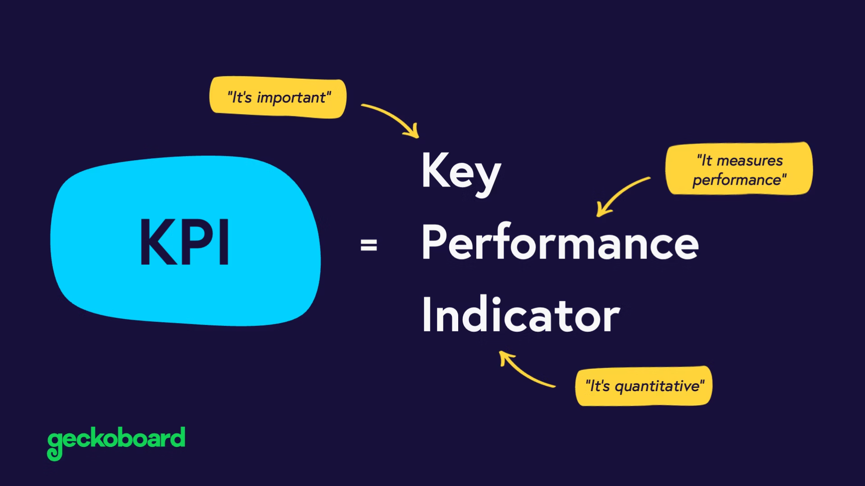
KPIs & Data Strategy: Measuring What Matters
Metric
Description & Source
Total Sales
Overall revenue ($1.20M).
Average Sales
Average sales per item ($141).
Number of Items
Total unique items (8,523).
Average Rating
Average customer rating (3.92).
Sales by Item Type
Item category sales (e.g., Fruits & Vegetables).
Sales by Outlet Type
Sales by store format (Supermarket Type1, Type2).
Sales by Outlet Size
Sales by outlet size (Small, Medium, High).
Sales by Tier
Sales across location types (Tier 1, 2, 3).
Item Visibility
Average visibility score of items (0.06–0.10).

Slide 4





Dashboard & Analysis: Unveiling the Insights
Order Frequency Trend
Sales by Outlet Type & Size
Fat Content Sales Split
15–18% decline in Bangalore & Mumbai.
Supermarket Type1 dominates; High-size underperform.
Low Fat items drive 64% of total sales.
Sales by Tier
Item Visibility vs. Sales
Tier 3 cities show the highest sales.
Visibility does not guarantee sales, revealing promotion opportunities.

Slide 5
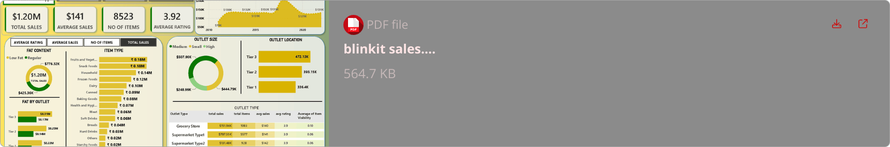
Integrated Dashboard: Power BI View

Slide 6
Recommendations: Data-Driven Solutions
Optimize Delivery Efficiency
Expand Dark Store Network
Targeted Promotions
Personalize offers for low visibility, high-potential items.
Implement dynamic routing for peak hours. Target a 20% faster delivery time. This will boost CSAT by 0.5 points.
Add 5 new dark stores in Bangalore & Mumbai. Reduce delivery times by 10% in key metros.
Reevaluate High-Size Outlets
Health-Focused Product Push
Convert them to fulfillment hubs or resize.
Double down on low fat and healthy options. These are already driving majority sales.

Slide 7
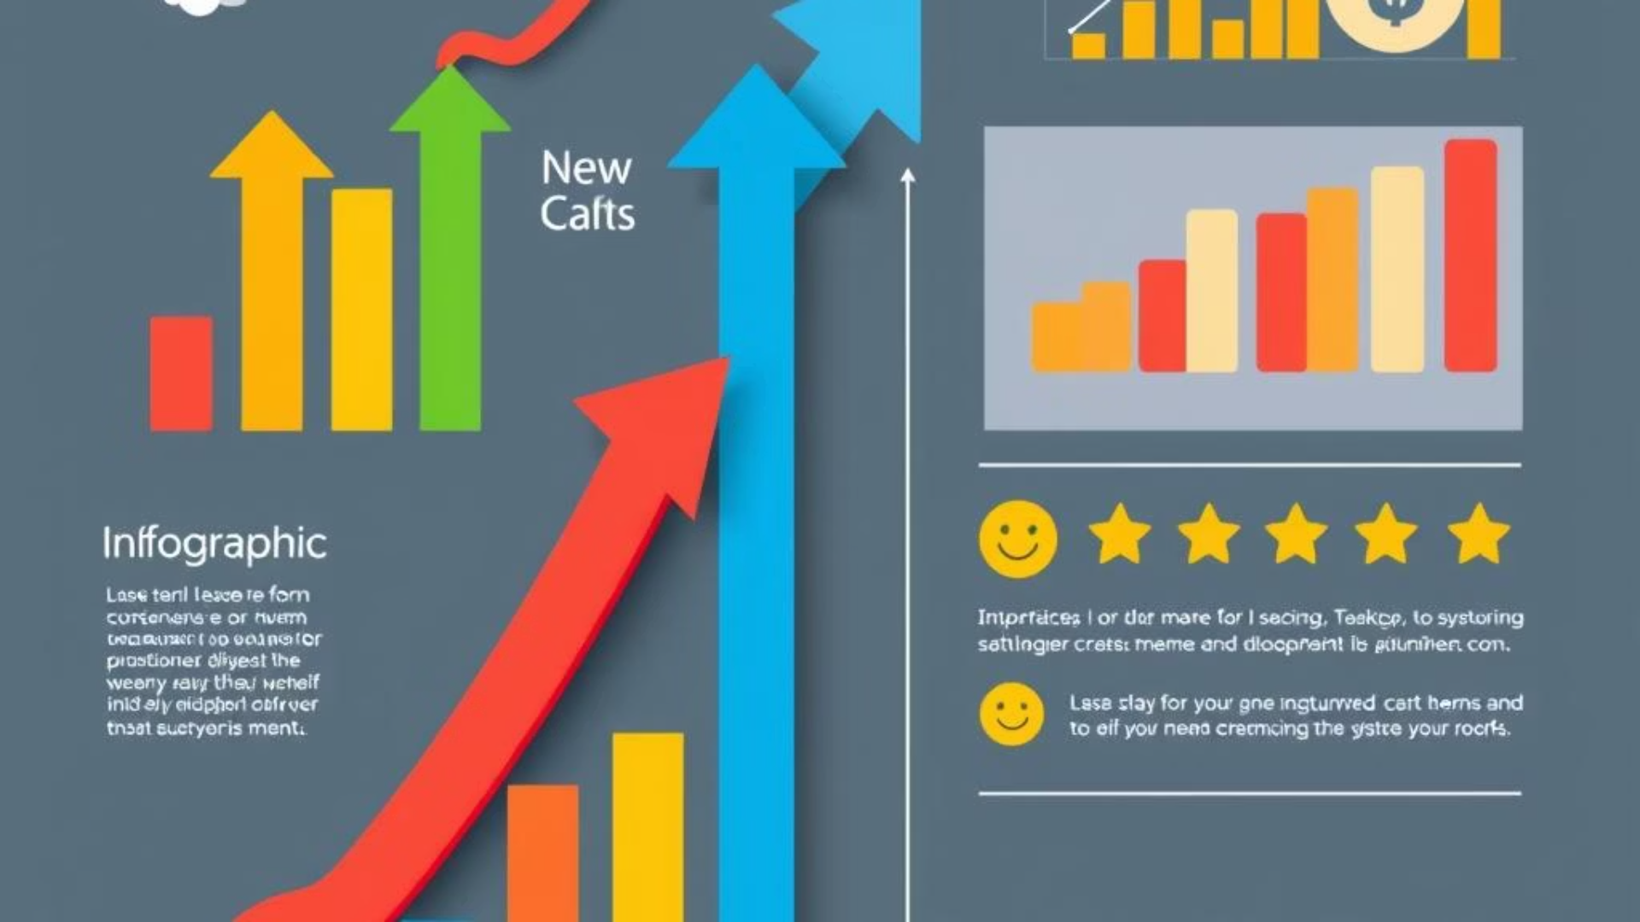
Business Impact: Quantifiable Results
10%
0.8
Order Frequency
CSAT Boost
Projected increase in 3 months.
Customer Satisfaction to rise.
5%
12%
Churn Rate
Revenue Growth
Decrease, retaining high-value customers.
Estimated lift next quarter.

Slide 8
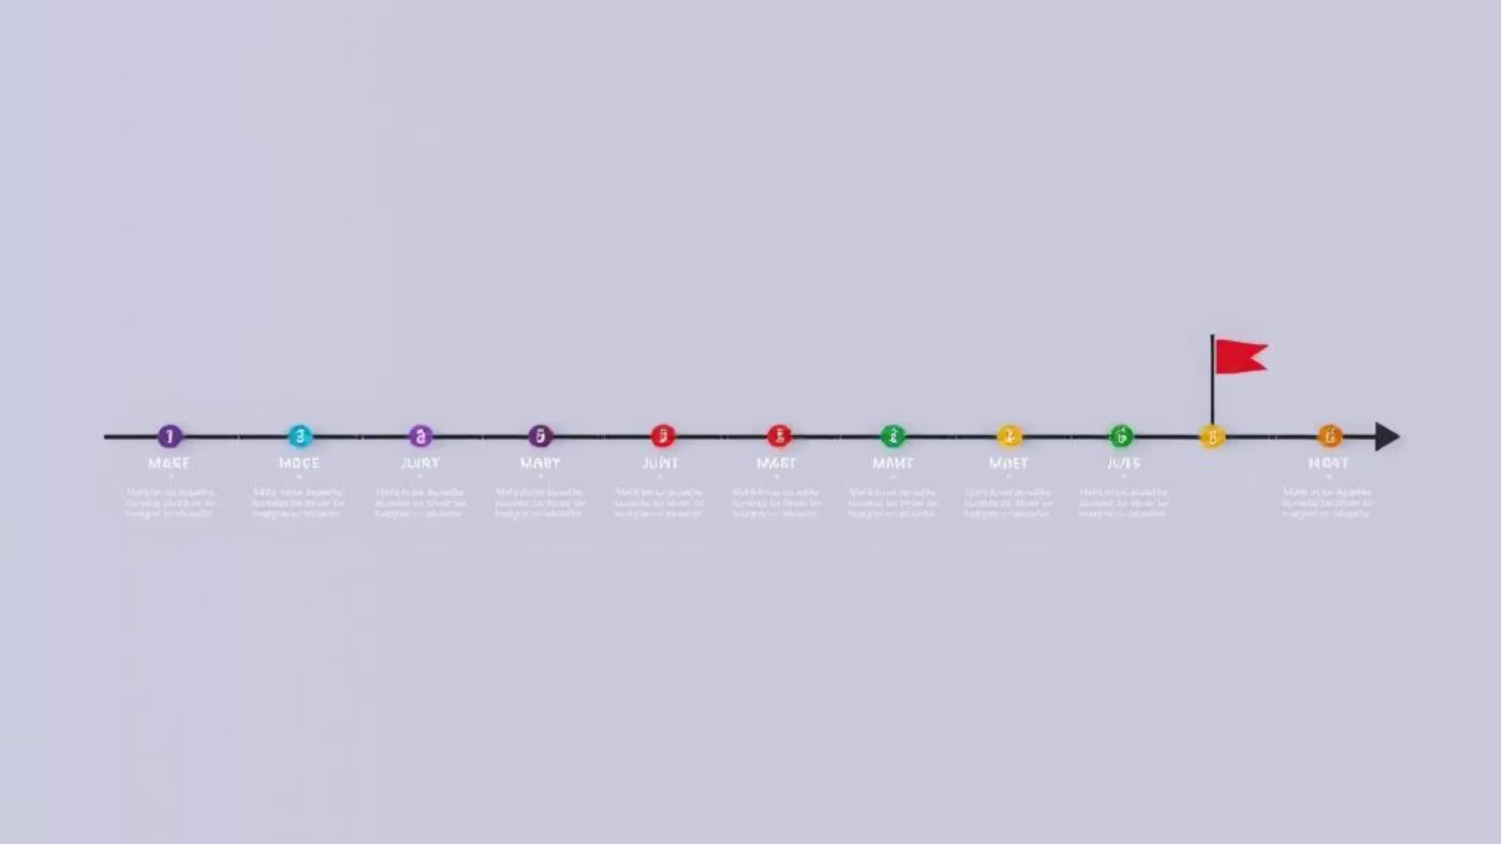



Implementation Roadmap: Timeline & Key Activities
Month 1
Dynamic routing and dark store analysis. Real-time Power BI monitoring for quick wins.
Month 2
Dark store expansion and competitor pricing alignment. Targeted promotions for low-performing items.
Month 3
Customer service and churn strategies. Continuous performance tracking in Power BI.

Slide 9
Conclusion: Data-Driven Growth for Blinkit
Integrated Insights
Strategic Decisions
Holistic view of sales, customer behavior, and outlet performance.
Reclaim market share in metros.
Capitalize on Tier 3 momentum.
Reduce churn and increase customer loyalty.
Continuous monitoring via the Power BI dashboard ensures agility and competitive edge.

